Slide 1
SPECIAL NEEDS CHILDREN
PRAGUE
SEPTEMBER 2017

Slide 2
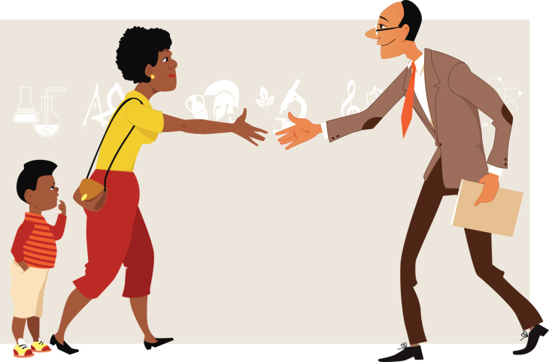
What is the most underused resource in education today?
This resource can increase student engagement and achievement and decrease a teacher’s workload.
The answer?
PARENTS.
Notes:
http://inservice.ascd.org/parental-involvement-a-neglected-resource/

Slide 3
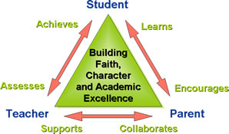
Reflection of Group Activity

Slide 4
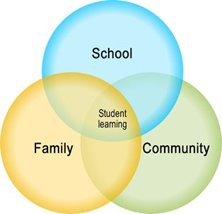

Slide 5
Conditions necessary for good cooperation of the home and school environment: We are working for the good of the same child. Let's unite forces and unify requirements and educational methods to achieve a better result. A good relationship requires: good will, openness, respect and sympathy, honesty, discretion.

Slide 6
The Three-Call Method
As early in the year as possible, teachers need to call as many parents on the phone as possible, hopefully all of them if their load is small enough.
The purpose of the call is to welcome the parent into the learning community and to establish a positive communication line.
Notes:
https://www.edutopia.org/blog/parent-teacher-collaboration-richard-curwin

Slide 7
Here's an example of the type of call: "Hello, Mr. Curwin. I'm David's teacher. I just want you to know how happy I am to have David in my classroom this year, and to let you know that if any problems should occur, I'd be happy to talk with you so we can work together to make things better."
The second call is to tell the parent something good the child has done. Stay away from superficial like dress and focus on behaviour, improvement and quality of work.
Only after these calls have been made should the teacher call about a problem; not before.
In this way, parents and teachers have already established a trusting, workable relationship that significantly diminishes blaming.

