Slide 1
SPECIAL NEEDS CHILDREN: EACH CHILD HAS DIFFERENT SPECIAL NEEDS
➤ Children with special needs may have:
mild learning disabilities
profound cognitive impairment
food allergies
serious illness
physical disorders
language difficulties
emotional problems

Slide 2
SPECIAL NEEDS CHILDREN: EACH CHILD HAS DIFFERENT SPECIAL NEEDS
➤ Children with special needs may have:
mild learning disabilities
profound cognitive impairment
food allergies
serious illness
physical disorders
language difficulties
emotional problems

Slide 3
SPECIAL NEEDS CHILDREN: TEACHER AS A MEDIATOR

Slide 4
SPECIAL NEEDS CHILDREN: DIFFERENTIATING INSTRUCTION
➤ Differentiated instruction
(also known as differentiated learning or, in education,simply, differentiation)
➤ Providing different students with different avenues to learning

Slide 5
SPECIAL NEEDS CHILDREN: INCLUSION
➤ Inclusion:
➤ Disabled people of all ages and/or those learners with 'Special
Educational Needs' labels being educated in mainstream
education settings alongside their nondisabled peers, where
there is a commitment to removing all barriers to the full
participation of everyone as equally valued and unique
individuals.
➤ Education for ALL!

Slide 6
Information easy to read and understand
Mgr. Magdaléna Olšinská

Slide 7
specific learning difficulty
learning disability
reduced intellectual ability
IQ < 70
mild learning disability: difficulty to understand complex information,
moderate: needs help with every day tasks
profound: full-time care and support with every aspect of their life
good IQ (70-130)
reading (dyslexia)
mathematics (dyscalculia)
writing (dysgraphia)
Atention disorder with hyperactivity ADHD

Slide 8
Information

Slide 9
Why do we need easy to understand information?
Convention on the rights of persons with disabilities, 2006
People with intellectual disabilities need to have an access to information
Good information helps people find out what they need to know. It helps them to make their own choices and decisions.

Slide 10
People with learning disability, autism, dyslexia, with different language, hearing and sight problems

Slide 11
Easy to read information online: health information - medical services, benefits – social service human rights – politic topic
Easy to read information at school:
-Instruction
-Rules at school
-Learning materials

Slide 12
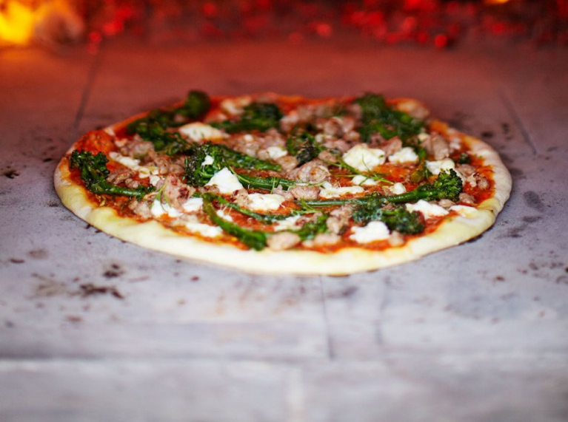
For the tomato sauce, peel and finely slice the garlic, then fry in a good amount of olive oil until lightly coloured. Pick and tear the basil leaves, then add to the pan with the tomatoes. Using the back of a wooden spoon, mush and squash the tomatoes as much as you can. Season to taste. As soon as it comes to the boil, remove the pan from the heat. Strain the sauce through a coarse sieve into a bowl, using the spoon to push any larger bits of tomato through. Discard the basil and garlic left in the sieve, but scrape any tomatoe goodness off the back of the sieve into the bowl. Pour the sauce back into the pan, bring to the boil, then lower the heat and simmer for 5 minutes. Cook until it’s the perfect consistency for spreading on your pizza bases. For the pizza dough, sieve the flour and salt onto a clean work surface and make a well in the middle. In a jug, mix the yeast, sugar and olive oil into 650ml lukewarm water and leave for a few minutes, then pour into the well. Using a fork, bring the flour in gradually from the sides and swirl it into the liquid. When it all starts to come together, work the rest of the flour in with your clean hands. Knead until you have a smooth, springy dough. Place the ball of dough in a large flour-dusted bowl and cover with a damp cloth and place in a warm room for an hour until the dough has doubled in size. Remove the dough to a flour-dusted surface and knead it around a bit to push the air out. You can use it immediately, or keep it, wrapped in clingfilm, in the fridge (or freezer) until required. If using straight away, divide the dough up into 6 to 8 balls. Timing-wise, it’s a good idea to roll the pizza bases out about 15 to 20 minutes before you want to cook them. Stack the pizza bases, with a square of oiled tin foil between each one, cover them with clingfilm, and pop them into the fridge. Now’s the time to get your wood-fired oven, or conventional oven, heated up to full whack. Place a couple of heavy baking trays in the oven to heat up, too. Meanwhile, click off the broccoli florets and roughly chop (using the stalk, too). Blanch in boiled salted water for 1 to 2 minutes, then drain. Tear the anchovies into small pieces, then deseed and finely chop the chilli. Squeeze the sausage meat out of their skins, then roll into small, rough meatballs. When you’re ready to assemble your pizzas, remove a tray from the oven, put a pizza base on it and assemble it quickly – smear tomato sauce on the base and dot with broccoli, torn up anchovy fillets and sausage meatballs. Tear over the Taleggio cheese and sprinkle with chilli. Crush and scatter over the fennel seeds. Place in the oven immediately while you prepare the remaining pizzas. If you’re using a wood-fired oven the pizzas should cook, one by one, in about 3 to 4 minutes – you want them to be puffed up, crispy and delicious. In a regular oven, they’ll take 8 to 10 minutes. Serve hot.
http://www.jamieoliver.com/

Slide 13
Use colour which is clearly seen at backgrounds
Never use a picture as a background
Never use a special writing design or italic
At least the size of Arial 14.

Slide 14
MOTHER MOTHER
Times new Roman Arial
Always use a font that is clear and easy to read.
A font is a type of writing.
For example good to read is:
- Arial
- Tahoma
- Calibri

Slide 15
How to make this information easier to understand?
Transport Company are authorised to perform inspection of adherence to Transport Terms of Service and the PIT Tariff in the operation of the metro, trams, the funicular and PIT buses. A transit inspector identifies himself with an inspector's badge belonging to the Prague Public Transport Company; upon request also with his company identification with photograph and number identical to the number of the inspector's badge.

Slide 16
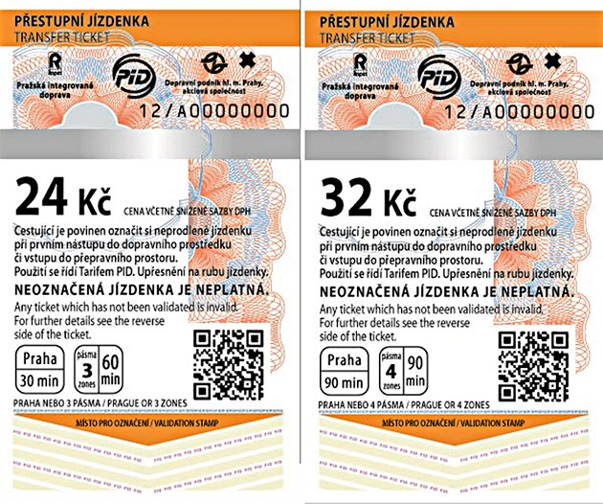
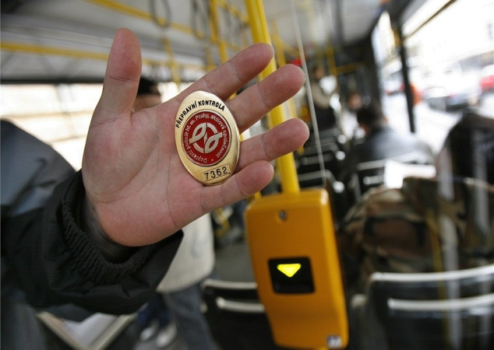
Inspection at Prague transport
If you travel by bus, tram or metro,
you need to buy a ticket.
When you enter the bus,
put the ticket into yelow marker and mark it.
An inspector can check your ticket.
If you do not have valid ticket,
you have to pay fine.

Slide 17
Keep sentences short!
Always start a new sentence on a new line.
Never split 1 word over 2 lines.
Highlight the important information in bold
Do not put too much text on your page.
Leave space between paragraphs.
Give only the important information

Slide 18
Speak to people directly.
Use words like “you” to do this.
Be careful when you use pronouns like
“I”, “him” or “it”.
Use the proper name instead.
repeat important information.

Slide 19
easy to understand words
examples that people will know from their everyday lives.
Use the same word to describe the same thing
Do not use words from other languages
Do not use difficult words. If you need to use difficult words, make sure you always explain them clearly.

Slide 20
discrimination
Discrimination means that somebody is unfair to you.
Or that somebody threats you differently,
just because you have some disability.

Slide 21
It is raining cats and dogs…
Do not use difficult ideas such as metaphors.

Slide 22
EU
Avoid using initials.
Initials are the first letter of every word.
Use the word in full where possible.
If you have to use initials, explain them. For example, if you write “EU”, explain that it stands for “the European Union

Slide 23
Percentages (63%), big numbers (1,758,625)
Try not to use percentages and big numbers. Instead, use words like “few” and “many” to explain what you mean.

Slide 24
“you will be sent a letter”.
active language is better:
“The doctor will send you a letter”

Slide 25
“You should not leave before the end of the meeting”.
Use positive sentences:
“You should stay until the end of the meeting”

Slide 26
Clear structure
Yesterday, I bought a green/yellow bike (a new one!) for my son – whose name is Michael.
My son’s name is Michael.
Yesterday, I bought a new bike for him.
The new bike is green and yellow.

Slide 27
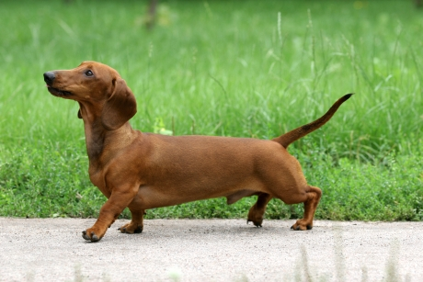
Images
Many people find it hard to read text. To help them understand your text, you should put images next to it to describe what it is about.
photographs, drawings, or symbols

Slide 28
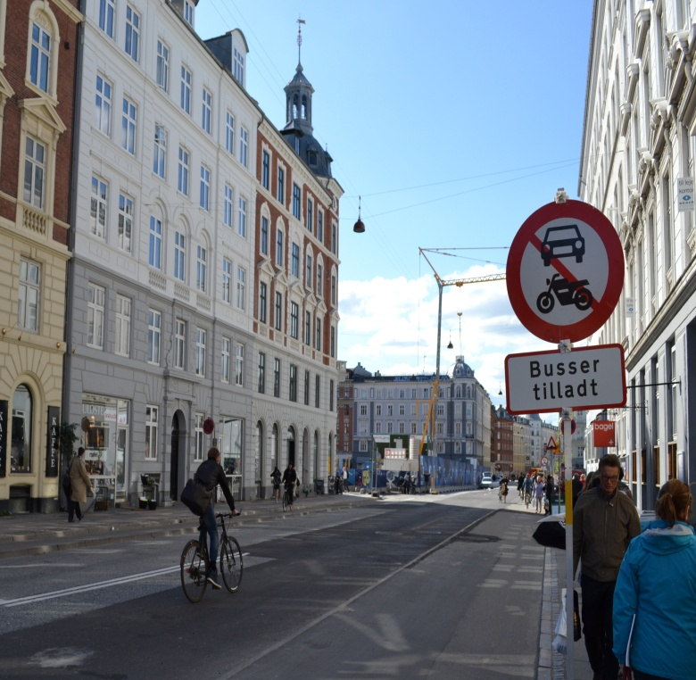
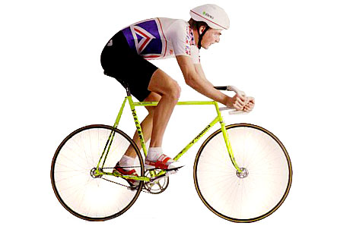
CYCLIST Which picture is better? Why?

Slide 29
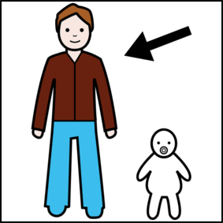
pictures
try to use the same style of images
always choose images that are clear
never use images for children
when you are writing for adults.

Slide 30
European easy-to-read logo
Your document must be written according to the rules called the European standards for making information easy to read and understand.
At least 1 person with intellectual disability read your document and said it was easy to read and understand.
http://easy-to-read.eu/?page_id=20

Slide 31
Task: make easy to read recipe
Work 2 together.
You can write in your language.
For example: make a sandwich / a cup of the tea.
Use clear structure!
1)
2)
3)

Slide 32
Picto selector

Slide 34
Web sites
http://www.easy-to-read.eu/ - principles
http://www.pecsforall.com/ - pictoselector
http://www.easyhealth.org.uk/ - examples
http://smartourismguide.com/
tourist information
https://www.mencap.org.uk/definition

