Slide 1
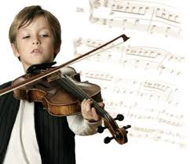
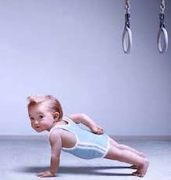
Gifted / talented child
Gifted refers to children with high potential
VS.
Talented means they display skills which are advanced when compared to other children of their age

Slide 2
What makes a child gifted and talented?
Giftedness is due to a combination of factors including what the child inherits genetically, the development of the child before birth, and the nurturing of the child.
It is generally accepted that a gifted child would have the potential to perform at a level that is significantly beyond that of the majority of other children of the same age, in one or more skill areas such as language, problem solving, physical or interpersonal skills.
A gifted child may have the potential to become, for example, a great artist, thinker or athlete.
A gifted and talented child not only has this potential, but is developing the skills to perform at this advanced level.

Slide 3
Intelligence and skills
A child may be gifted and talented in one of these areas, or in many areas.
Logical and mathematical (eg. number, classification and problem solving ability)
Verbal/language (eg. reading, writing and speaking ability)
Visual and performing arts (eg. drawing, painting, musical ability)
Body/movement/psychomotor ability (eg. dance, athletic ability)Interpersonal (eg. communication, leadership ability)
Intrapersonal (eg. reflective, self sufficient ability)

Slide 4
Multiple intellingences
Theory proposed by Howard Gardner in the early 1980s. He believed that the way intelligence was measured before the 1980s often left some extremely talented and gifted children behind. For example, a student could be musically gifted and play perfect violin solos in second grade, but be unable to memorize their multiplication tables.
Your gifted students could excel in one or more of the following intelligences:
kinesthetic
interpersonal
verbal
logical
naturalistic
intra-personal
visual
musical

Slide 5
Hidden Gifted
Special attention should be given to the 'hidden gifted'.
These include:
disadvantaged gifted
disabled gifted
those with learning difficulties
underachieving gifted
those from minority cultural and ethnic groups

Slide 6
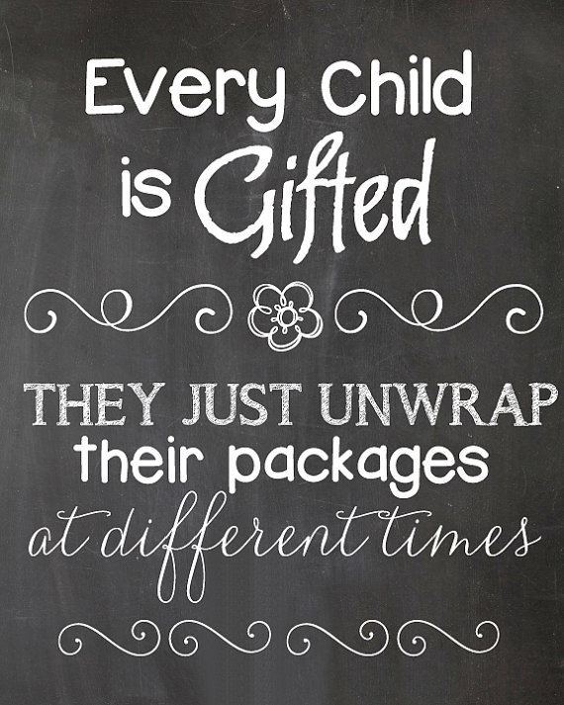

Slide 7
Recommendations for teachers
Select a broad topic or many connected topics where students can compile their own research.
Suggest creative ways that the students can present the information.
Create a rubric to assess the project.
Make a project sheet that has deadlines, check points, and descriptions of tasks.
Designate defined roles for each member of the group so that everybody contributes.

Slide 8
Activities suggested
Connecting to Themes in Literature
When teachers select a theme, they can center the whole semester or even.
This gives continuity to the school year and allows students to make educational connections.
Themes can connect to literature themes, such as the following:
a great journey
good versus evil
growing up
family relationships
connection to supernatural

Slide 9
Write a newspaper article Students become reporters about the topic. The teacher can create an "event." The students can create a newspaper article or even an entire newspaper.
Make a topic research
Students make a research on the issue established by the trachet on the Internet. Than, they create documentaries about the theme. They could interview experts, recreate evidence in their research, show pictures from their research, etc.

Slide 10
D. Literary Techniques and Free Verse
Objective: Teaching metaphor, simile, alliteration, onomatopoeia, and other literary techniques can be enhanced by poetry written in free verse. This not only allows the student freedom from traditional rhyme and meter, it also challenges them to look outside the proverbial box.
Begin this language arts project with the following items.
A handout of literary techniques.
Photographs or art work to use as prompts for writing.
An alternate prompt might be a list of characters from literature to describe or situations in current events.

Slide 11
E. Internet Exploratory Activities
You can show students how to search online, how to choose which sites are of the highest quality, and how to find sites that actually address the issues that they would like to research. Then, let them do additional research about a topic that interests them. E.g. if the topic is the Ancient Rome, some students might like to do Internet research on what people wore in Ancient Rome, while others might like to read about what a kid's life was like in Ancient Rome. Some may even be curious about the weapons used in Ancient Roman warfare. Let them explore the topic that most interests them and encourage them to give a short written or oral presentation to share what they have learned with the rest of the class.

Slide 12
Lessons Specifically for Advanced Learners
Lessons to capture advanced learners' imaginations, inspiring them to step out of their comfort zones to investigate, research, create, develop and produce assignments that are evidence of their best work are imperative. Here are some engaging lessons for the advanced learner.
Shakespeare for Gifted Students
Unsolved Mysteries Lesson Plans for Gifted Students
Language Arts Projects for Gifted Students
Tapping into the Artistic Talents of Gifted Students
Math for Gifted First Graders
Elapsed Time Lessons for Gifted Third Graders

Slide 13
Issues and Problems
Social Factors that Cause Gifted Students to Fall Behind
Classroom Behavior Management for Gifted and Talented Programs
Social and Emotional Health of Gifted Students
Working with Gifted Student with Disabilities
Unusual Behaviors of Gifted Students
List of Social Issues that Gifted Students Face in School
Addressing the Emotional Needs of Gifted Children
Recess - An Important Aspect of Growth for Gifted Students

Slide 14
Assessing Advanced Learners
Assessing a student with exceptional talents can sometimes be difficult, simply because they score off the rubric. Developing various means of assessing, other than standardized testing, helps give both the student and the teacher a clear idea of progress gained.
Assessing Gifted Students with Bloom's Taxonomy
Using Portfolios for Gifted Children
Measuring Gifted Students Academic Output
Project Assessment Tool for Year-long Service Learning Projects
Self-Assessment with Interest Sheets for Gifted Students

